Slide 2
Unit 3: Continuous System (8 hrs)
3.1 Introduction To Continuous System
3.2 Representation Of Continuous System Using Differential Equation
3.3 Linear And Nonlinear Differential Equations And Its Examples
3.4 Analog Computer (Components And Examples)
3.5 Digital Analog Simulators
3.6 Hybrid Computers
3.7 CSSLs, CSMP III
3.7.1 Structured Statement
3.7.2 Data Statements
3.7.3 Control Statements
3.8 Feedback System With Example
3.9 Interactive System

Slide 3
Continuous System
A continuous system is one in which the state variable(s) change continuously over time.
The system’s predominant activities cause smooth changes in the attributes of the system entities.
When such systems are modeled mathematically, the attributes of the system are controlled by a continuous function.
The continuous system is modeled using differential equations.

Slide 4
Continuous System Examples
System | Description
Water flowing in a pipe | The flow rate and pressure change smoothly over time.
Temperature control system | Temperature gradually increases or decreases.
Speed of a car | Speed varies continuously as the driver accelerates or brakes.
Electrical circuits | Current and voltage vary continuously with time.
Chemical reactions | Concentrations of substances change over time.

Slide 5
Differential and Partial Differential Equations
Differential Equation
The equation that consists of the higher order derivatives of the dependent variable is known as differential equations.
A differential equation is a mathematical equation that relates some function with its derivatives.

Slide 6
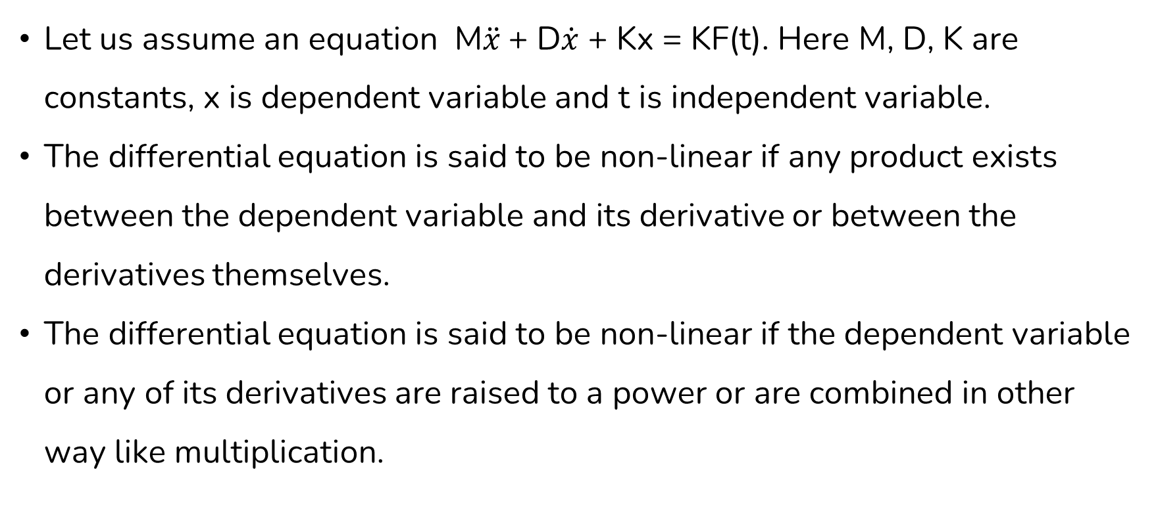
Non-Linear Differential Equation
Let us assume an equation M$\ddot{x}$+ D$\dot{x}$ + Kx = KF(t). Here M, D, K are constants, x is dependent variable and t is independent variable.
The differential equation is said to be non-linear if any product exists between the dependent variable and its derivative or between the derivatives themselves.
The differential equation is said to be non-linear if the dependent variable or any of its derivatives are raised to a power or are combined in other way like multiplication.

Slide 7
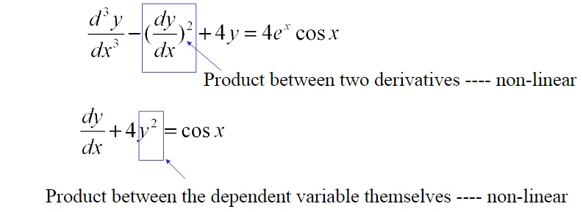
Non-Linear Differential Equation

Slide 8
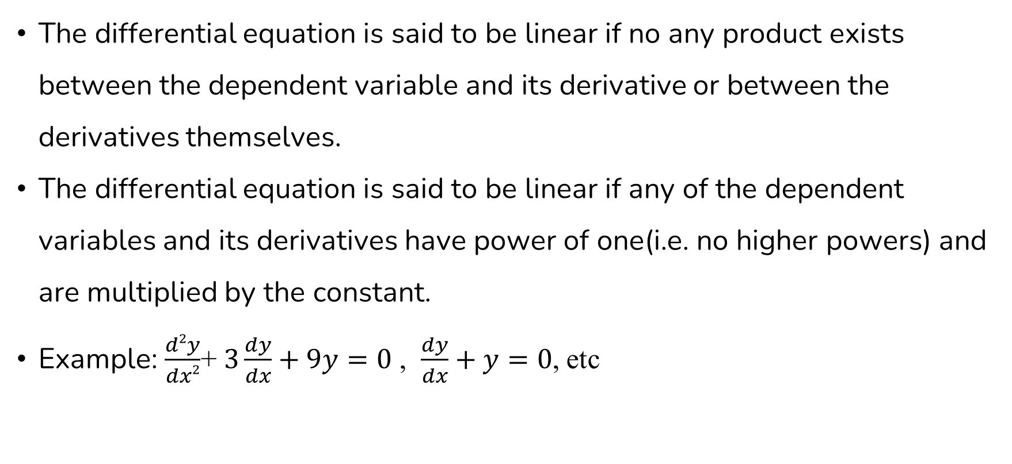
Linear Differential Equation
The differential equation is said to be linear if no any product exists between the dependent variable and its derivative or between the derivatives themselves.
The differential equation is said to be linear if any of the dependent variables and its derivatives have power of one(i.e. no higher powers) and are multiplied by the constant.
Example: $\frac{d2y}{dx2}$+ $3\frac{dy}{dx}+9y=0$ , $\frac{dy}{dx}+y=0$, etc

Slide 9
Partial Differential Equation
When more than one independent variable occurs in a differential equation, the equation is said to be partial differential equation.
A partial differential equation (PDE) is an equation involving functions and their partial derivatives.

Slide 10
Necessity of Differential Equation
Most physical and chemical process occurring in the nature involves rate of change, which requires differential equations to provide mathematical model.
It can be used to understand general effects of growth trends as differential equations can represent a growth rate.

Slide 11
Analog Computers
Analog computers are a type of computer that represent data as continuous physical quantities rather than as discrete digital signals.
They are particularly suited for simulating systems that can be described using differential equations, such as electrical, mechanical, or hydraulic systems.

Slide 12
Features of Analog Computers
Feature | Description
Data Representation | Uses continuous variables (voltage, current, etc.)
Computation Method | Solves problems by modeling equations physically using circuits
Speed | Extremely fast for real-time operations
Accuracy | Limited by physical precision of components
Flexibility | Less flexible compared to digital computers

Slide 13
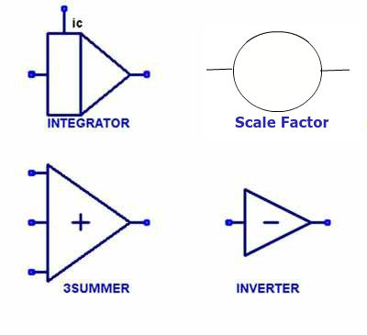
Components of an Analog Computer
The general method by which analog computers are applied can be demonstrated using the second-order differential equation.
The general method to apply analog computers for the simulation of continuous system models involves following components:

Slide 14
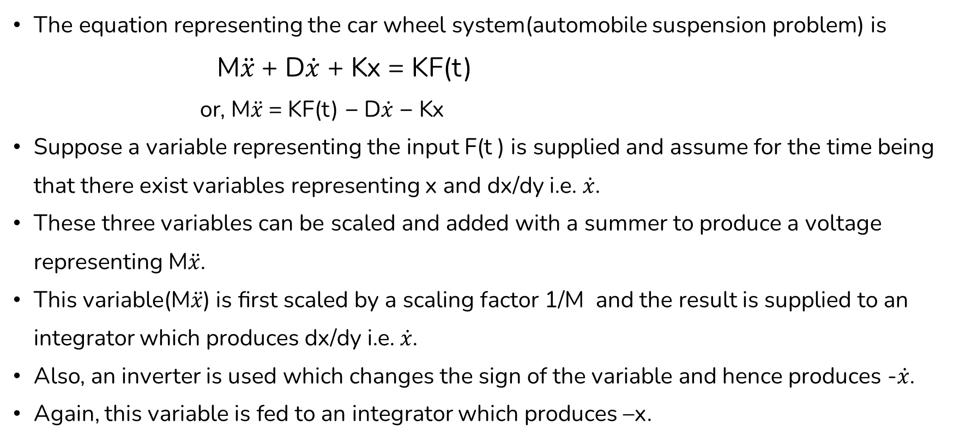
Analog Methods
The equation representing the car wheel system(automobile suspension problem) is
M$\ddot{x}$+ D$\dot{x}$ + Kx = KF(t)
or, M$\ddot{x}$= KF(t) − D$\dot{x}$ − Kx
Suppose a variable representing the input F(t ) is supplied and assume for the time being that there exist variables representing x and dx/dy i.e. $\dot{x}$.
These three variables can be scaled and added with a summer to produce a voltage representing M$\ddot{x}$.
This variable(M$\ddot{x}$) is first scaled by a scaling factor 1/M and the result is supplied to an integrator which produces dx/dy i.e. $\dot{x}$.
Also, an inverter is used which changes the sign of the variable and hence produces -$\dot{x}$.
Again, this variable is fed to an integrator which produces –x.

Slide 15
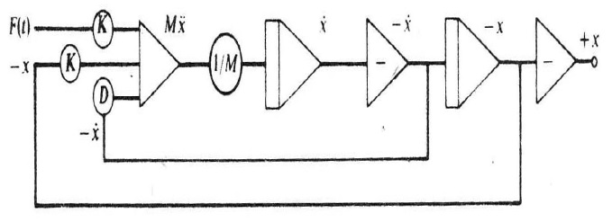
Analog Methods
For convenience, a further sign inverter is included to produce +x as an output.
Block Diagram to solve the automobile suspension problem is shown below:
Figure: Diagram for automobile suspension problem

Slide 16
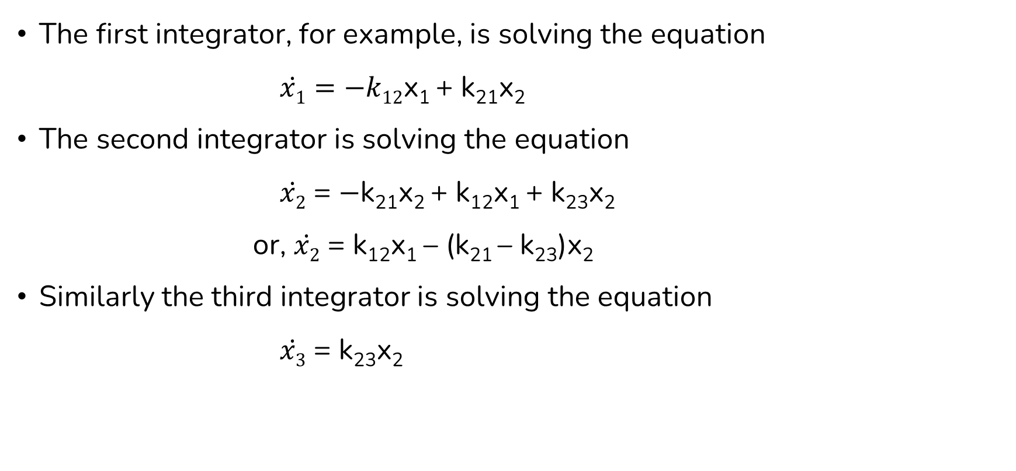
Analog Methods
The first integrator, for example, is solving the equation
$\dot{x1}=−k12$x₁ + k₂₁x₂
The second integrator is solving the equation
$\dot{x2}$ = $−$k₂₁x₂ + k₁₂x₁ + k₂₃x₂
or, $\dot{x2}$ = k₁₂x₁ – (k₂₁ – k₂₃)x₂
Similarly the third integrator is solving the equation
$\dot{x3}$ = k₂₃x₂

Slide 17
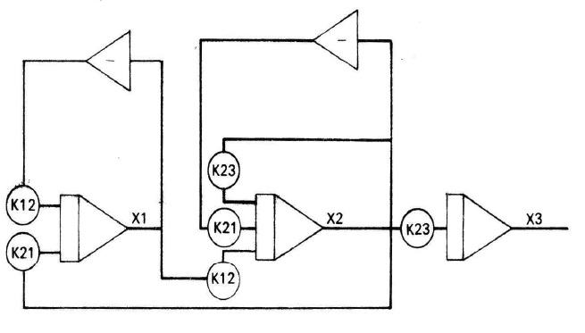
Analog Methods

Slide 18
Advantages of Analog Simulation
Many signal values can be computed simultaneously in parallel.
Computation can be done for some applications without the requirement for transducers to convert the inputs/outputs to/from digital electronic form.
Setup requires the programmer to scale the problem for the dynamic range of the computer. This can give insight into the problem and the effects of various errors.

Slide 19
Disadvantages of Analog Simulation
Computation elements have a limited useful dynamic range, usually not much more than 120 dB, about 6 significant digits of accuracy.
Useful solution to problems of any size can take an inordinate amount of setup time (though modern analog computers have interfaces that make setup substantially easier than it used to be).
For a given size (mass) and power consumption, digital computers can solve larger problems.
Solutions appear in real (or scaled) time, and maybe difficult to record for later use or analysis.

Slide 20
End of Lecture 8

Slide 21
Digital Analog Simulators Hybrid Computers CSSLs, CSMP III

